Slide 1
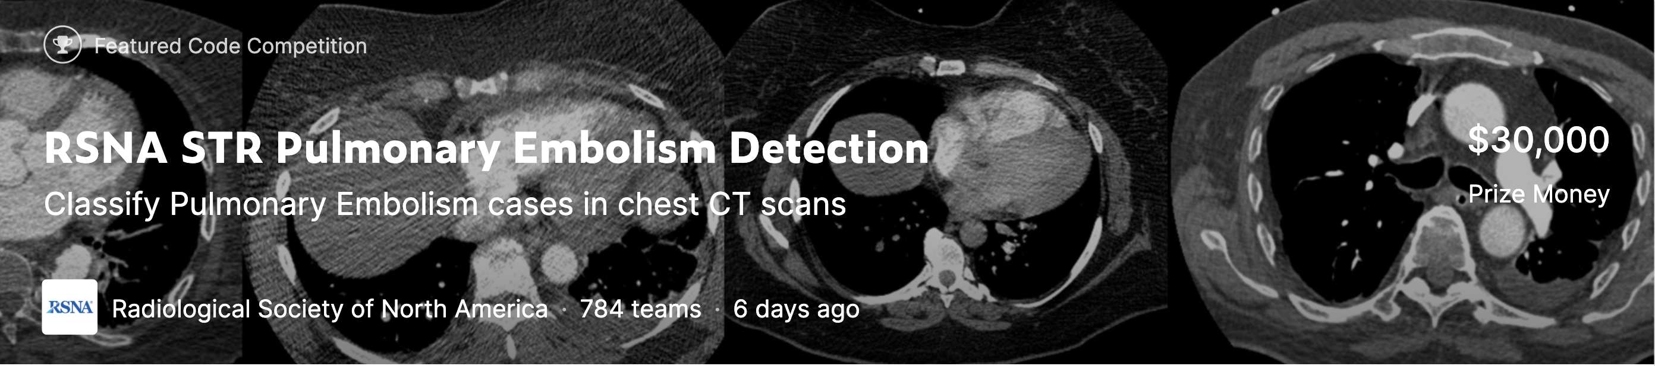

Winner presentation – 5th Place Solution
Darragh Hanley
Radiological Society of North America (RSNA®) has teamed up with the Society of Thoracic Radiology (STR)
Nov 2020

Slide 2
Team
Darragh Hanley is an AI engineer at DoubleYard focused on computer vision reserach. He also lectures at Berkeley MIDS program.

Slide 3
Components of proposed solution
Windowing
Cropping and augmentation
Image Classification
GAP Layer Extraction
Sequential Modelling
Bagging
Hardware :
Ubuntu 16.04 LTS (512 GB boot disk) A100 DGX Station (Single card)
Software :
Pytorch, Python, Docker, Albumentations, timm, Scikit-learn, pytorch_image_models

Slide 4
Components of proposed solution
There are at the 3 windows that a radiologist typically inspects for each scan.
RED channel / LUNG window / level=-600, width=1500
GREEN channel / PE window / level=100, width=700
BLUE channel / MEDIASTINAL window / level=40, width=400
Each channel is stored in a different channel within a jpeg file to easy loading to models. If you would like more detail on windowing, check out this description.
Windowing
Cropping and augmentation
Image Classification
GAP Layer Extraction
Sequential Modelling
Bagging
Dicom
File
Credits
@IanPan

Slide 5
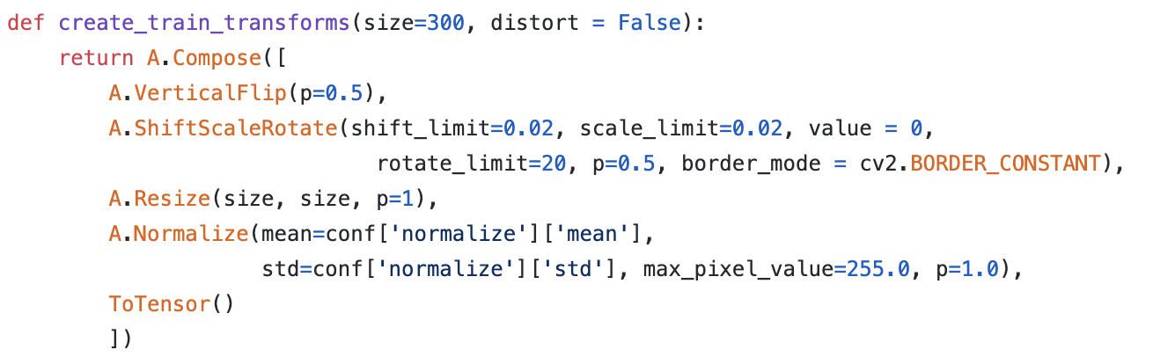
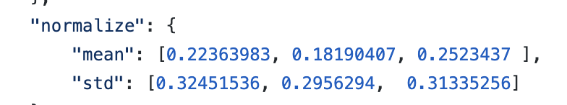
Components of proposed solution
Used the albumentations library
Windowing
Cropping and augmentation
Image Classification
GAP Layer Extraction
Sequential Modelling
Bagging

Slide 6
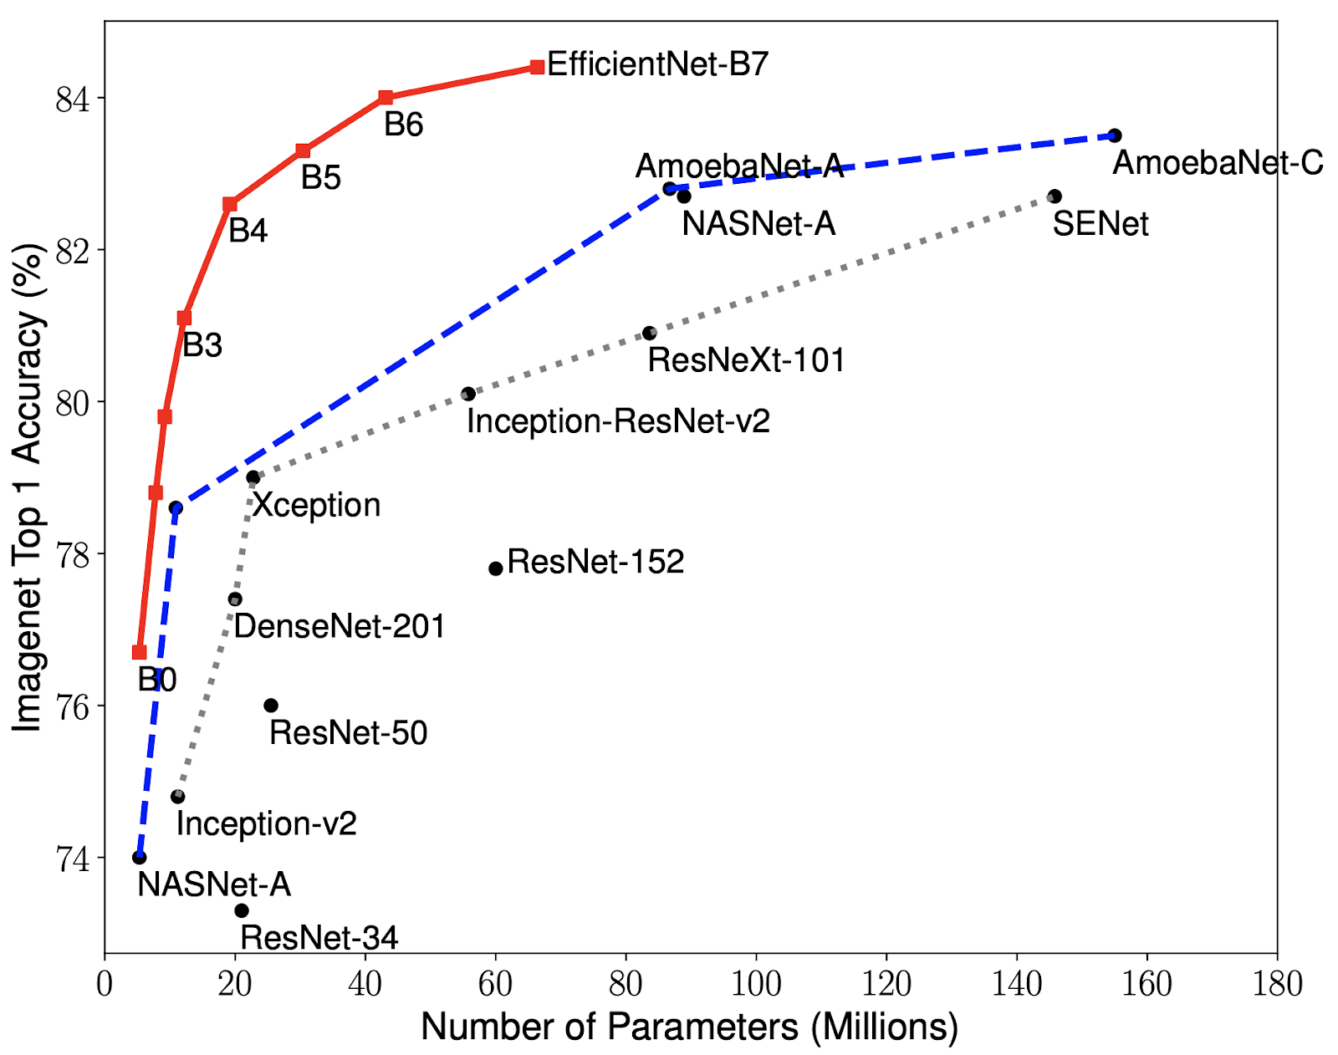
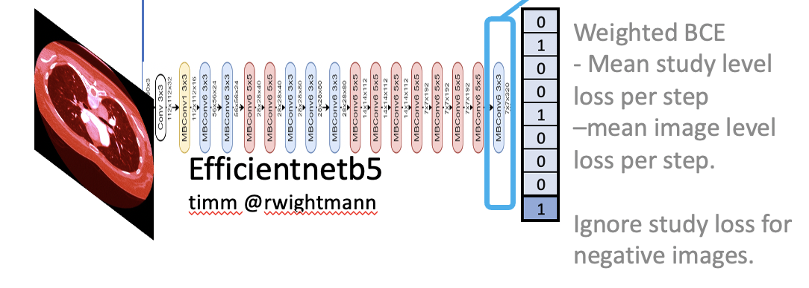
Components of proposed solution
EfficientNet: Rethinking Model Scaling for Convolutional Neural Networks, Mingxing Tan and Quoc V. Le, CoRR abs/1905.11946, 2019
Windowing
Cropping and augmentation
Image Classification
GAP Layer Extraction
Sequential Modelling
Bagging
Credits
@googleresearch

Slide 7
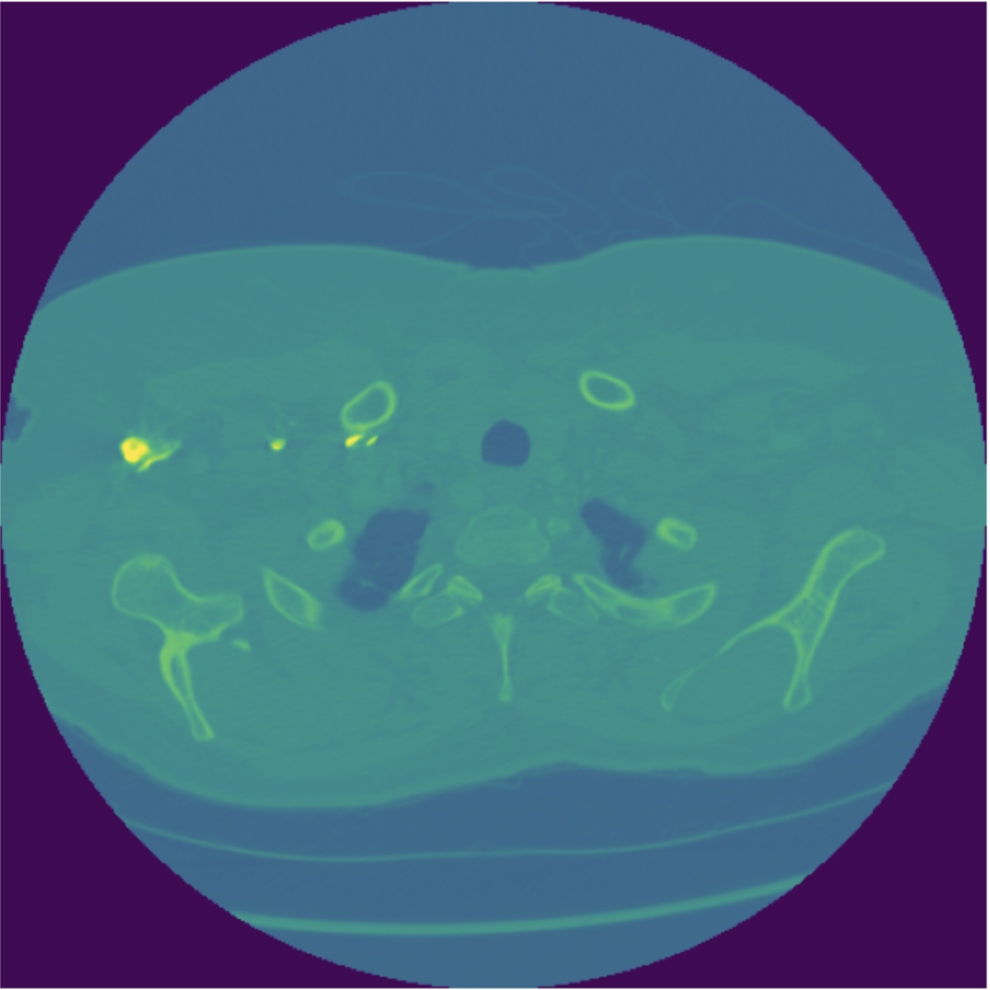
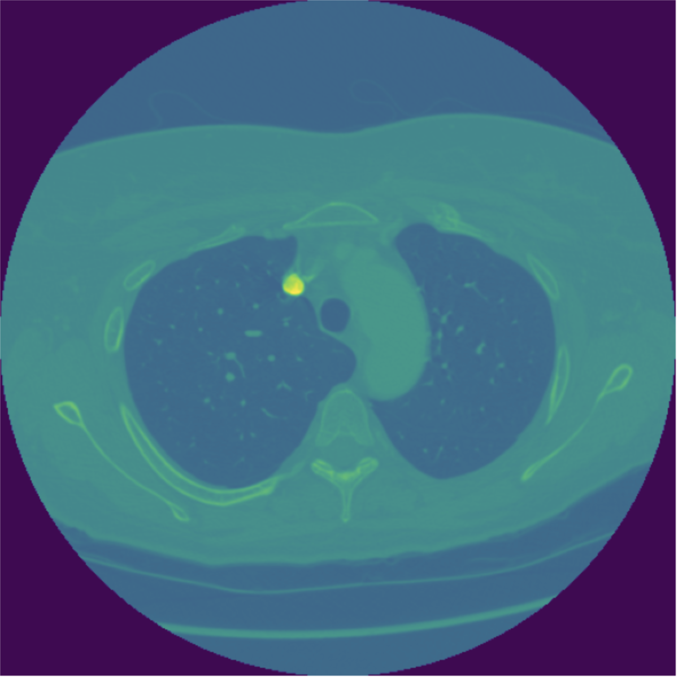
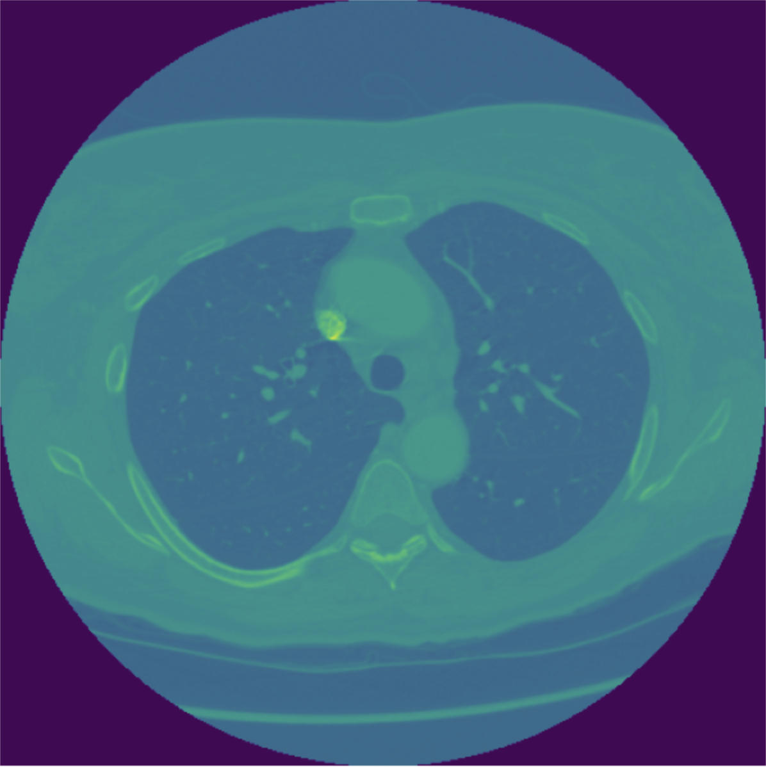
Components of proposed solution
Slice labels
Time
Study labels
Windowing
Cropping and augmentation
Image Classification
GAP Layer Extraction
Sequential Modelling
Bagging

Slide 8

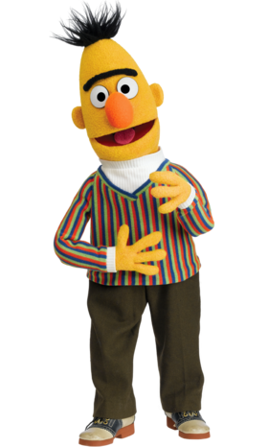
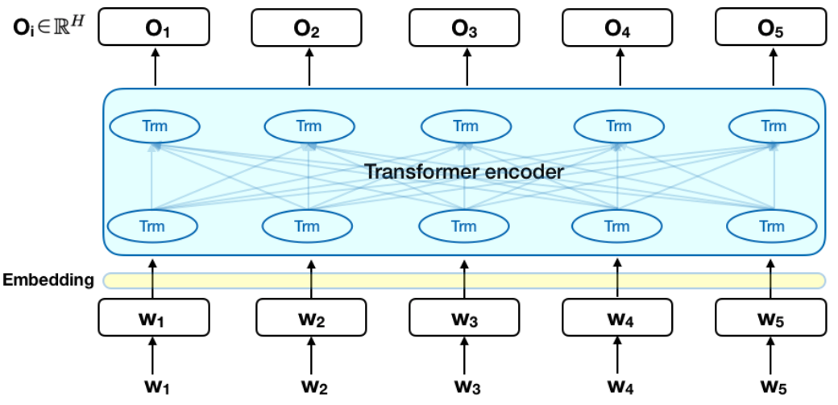
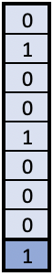
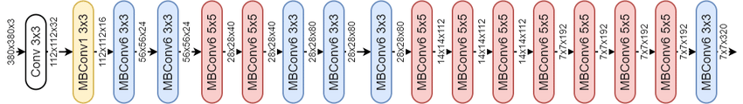
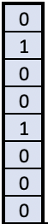
Components of proposed solution
CT Scan Sequence on Study
Windowing
Cropping and augmentation
Image Classification
GAP Layer Extraction
Sequential Modelling
Bagging
2048 embedding
2 X Bi-BLSTM
- 1 layer 8 head 2048 hidden
- 2 layer 8 head 1024 hidden
Dense block 4096 X 4096
Sum LSTM & Dense layers
Mean 3 folds 12 epochs of each
Study level
Image level
Weighted BCE loss

Slide 9
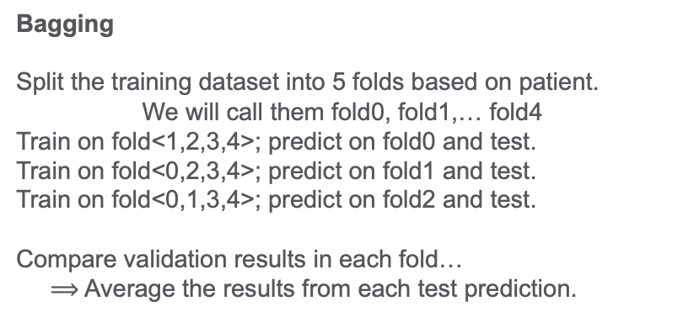
Components of proposed solution
Windowing
Cropping and augmentation
Image Classification
GAP Layer Extraction
Sequential Modelling
Bagging
Bagging
Split the training dataset into 5 folds based on patient.
We will call them fold0, fold1,… fold4
Train on fold<1,2,3,4>; predict on fold0 and test.
Train on fold<0,2,3,4>; predict on fold1 and test.
Train on fold<0,1,3,4>; predict on fold2 and test.
Compare validation results in each fold…
$⟹$ Average the results from each test prediction.

Slide 10
Solution link
Link to repo
Github : https://github.com/darraghdog/rsnastr
Submission scripts with weights:
https://www.kaggle.com/darraghdog/rsnastr2020-prediction
Competition :
https://www.kaggle.com/c/rsna-intracranial-hemorrhage-detection/overview

Slide 11
Thank you!

Slide 12
Windowing @IanPan:
> Lung
> PE
> MediaStinal
Light Augmentation vflip & shiftscale
CT Scan Sequence on Study
Dicom
Files
Subsample 4:1 -ve to +ve samples, with at least two images per study each epoch.
2048 embedding
2 X Bi-BLSTM
- 1 layer 8 head 2048 hidden
- 2 layer 8 head 1024 hidden
Extract GAP layer for train and test dim 2048, 20 epochs – using only 3 folds
Dense block 4096 X 4096
Weighted BCE
- Mean study level loss per step
–mean image level loss per step.
Ignore study loss for
negative images.
Sum LSTM & Dense layers
Mean 3 folds 12 epochs of each
Efficientnetb5
timm @rwightmann
Study level
Image level
Weighted BCE loss

